Slide 1
DB CACHING USING FIREBASE
ADITI YAWALE
ASSOCIATE INTERN
OMNEVU.COM - ASSIGNMENT

Slide 2
PROBLEM STATEMENT
To use Realtime Database as a cache layer and Firestore the main database layer.
To reduce latency by serving frequently accessed data quickly from the cache.
To minimize Firestore reads and costs for repeated access to the same data
To improve performance and scalability for real-time applications with multiple users.

Slide 3
motivation
Firestore is scalable but charges per read/write.
Repeated reads of the same data leads to high latency & cost.
We can reduce Firestore reads and improve response time by Implementing a caching layer using RTDB
Due to Real-time Updates, RTDB syncs instantly to clients.

Slide 4
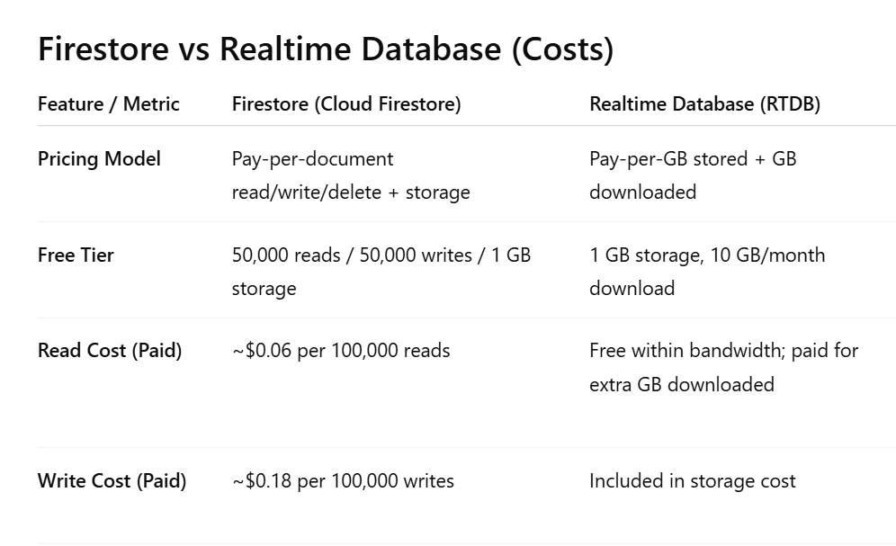
motivation

Slide 5
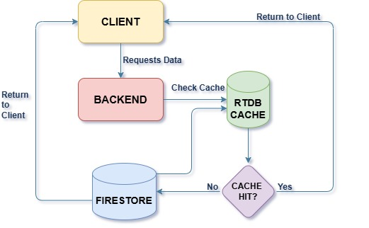
system architecture

Slide 6
Reference document
https://developers.google.com/looker-studio/connector/firebase-cache

Slide 7
thankyou

